Slide 1
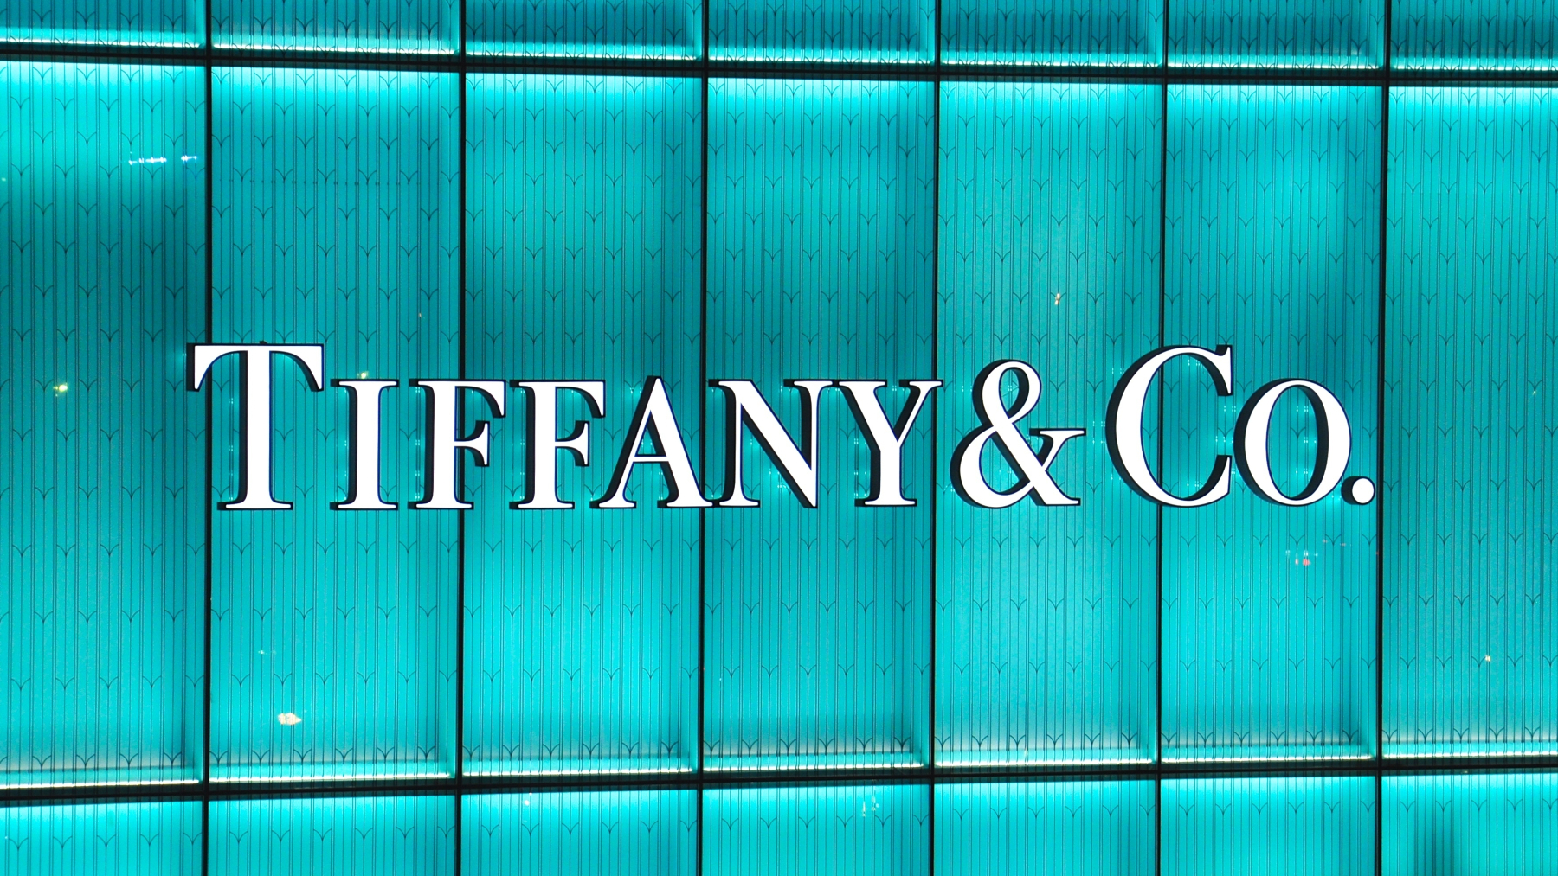
By: Olivia Haines, Liliana Shutt, Ruby Calabrese

Slide 2

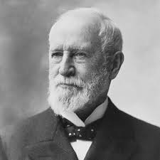
Introduction
Established in 1837 by Charles Lewis Tiffany
Luxury jewelry brand
Known for diamonds and craftsmanship
Headquarters New York City

Slide 3
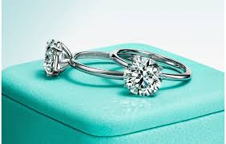
Luxury Sector-Brands Standing
Jewlery Industry
-high end jewelry, watches, and accessories
Competitor: Harry Winston
Standing: One of most iconic names in jewelry industry
-Rich history
-Craftsmanship
-Brand Recognition
-Sustainability and corporate responsibility

Slide 4
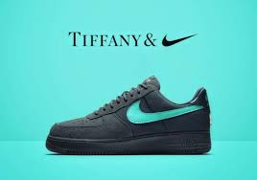
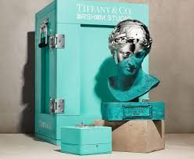
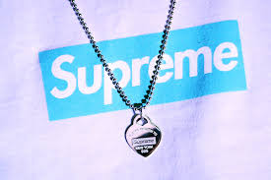
Collaborations-Art
1.Off-White & Supreme: appeal to younger audience/ promotes fashion forward pieces
2. Partnership with Daniel Arsham: limited addition t-bracelet inspired by bronze eroded Venus of Arles sculpture.
-bracelets came in limited edition blue box
3. Nike collaboration: Nike/ Tiffany Air Force 1 1837 black premium suede with Tiffany blue swoosh.

Slide 5
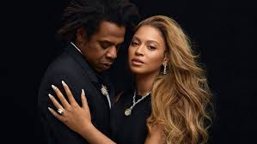

Anti-laws
Follows
1."The role or advertisement is not to sell"
-dream comes first
-dream of diamonds and New York City
2."Luxury sets the price, the price does not set luxury"
- Tiffany markets products on love, commitment, and monumental moments in one's life
-emotional connection with consumer
Does not follow
3. "Keep stars out of your advertisements"
-Stars involved: Beyoncé, Lady Gaga, and Emma Roberts

Slide 6

History & Heritage
Tiffany and Co was founded in 1837 by Charles Lewis Tiffany.
Tiffany & Co was originally established as a stationary gift store, which then gained a reputation that included high-quality goods.
Tiffany had a passion for the rarest and most extraordinary gemstones.
Tiffany Blue became their signature color in 1845, remaining as a fundamental part of their brand identity.
Tiffany's heart motif is a heart design that they have integrated into their products and jewelry which symbolizes love & affection for the brand.
https://www.instagram.com/innovations_mastery/reel/DCX5_oyNUK1/

Slide 7

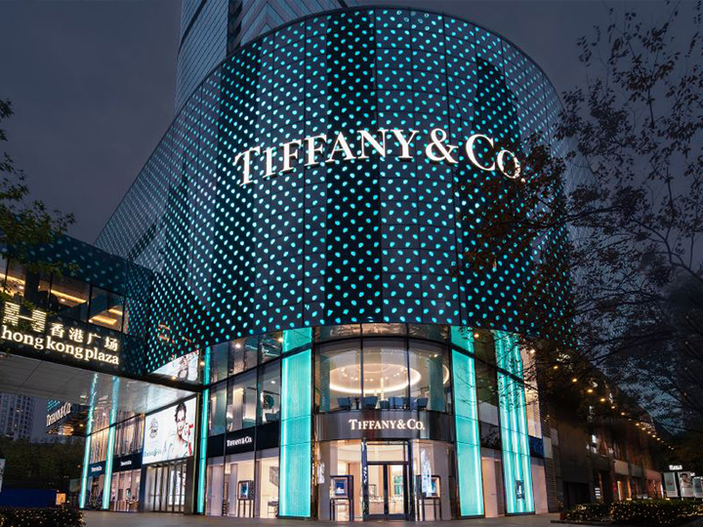
Localization
Tiffany & Co actively expands globally to enhance their consumer's shopping experience.
  Tiffany & Co has opened locations in popular cities like London and is expanding their presence in Asia.
Tiffany & Co has a significant focus on Asia in their global expansion & renovation efforts.
  Reconstructing stores to fit within the norms of typical consumers within that area.
Ex./ Tiffany & Co working with Asian celebrities (Eileen Gu – skier & model), appealing to younger & affluent customers in the growing luxury market.
  Campaigns in China highlight romantic themes & gifting traditions that align with Chinese holidays.

Slide 8

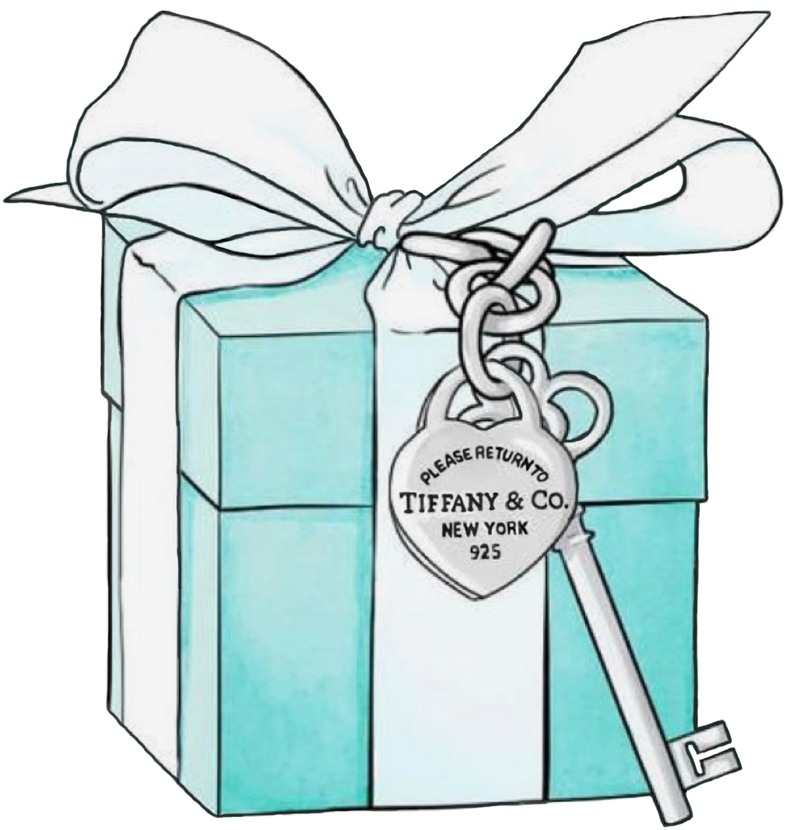
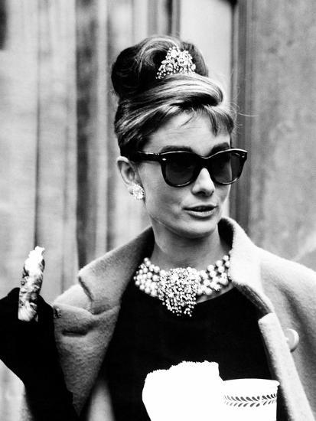
Brand Identity Prism
Tiffany & Co Brand Identity Prism:
PHYSIQUE: Physical features of your brand: colors, patterns, styles. | Tiffany Blue, Tiffany Engagement Ring, Heart Pendants
RELATIONSHIP: Brand's relationship with its ideal customers. | Emotionally Significant (celebrating meaningful moments); Accessible Exclusivity; Trust & Reliability through special moments)
REFLECTION: How your ideal customer wants others to see himself/herself. | Affluent, Stylish, & Romantic Individuals who value tradition & timeless elegance
PERSONALITY: Brand personality and temperament. | Sophisticated, aspirational, romantic, and refined (timeless, celebrating love & significant moments)
CULTURE: History, origin, heritage of your brand. | Quality Craftsmanship (commitment to exceptional design & materials) and American Luxury (NYC)
SELF-IMAGE: How your ideal customer sees himself/herself. | Wearing T&C makes customers feel sophisticated, cherished, and part of an exclusive luxury culture.​

Slide 9
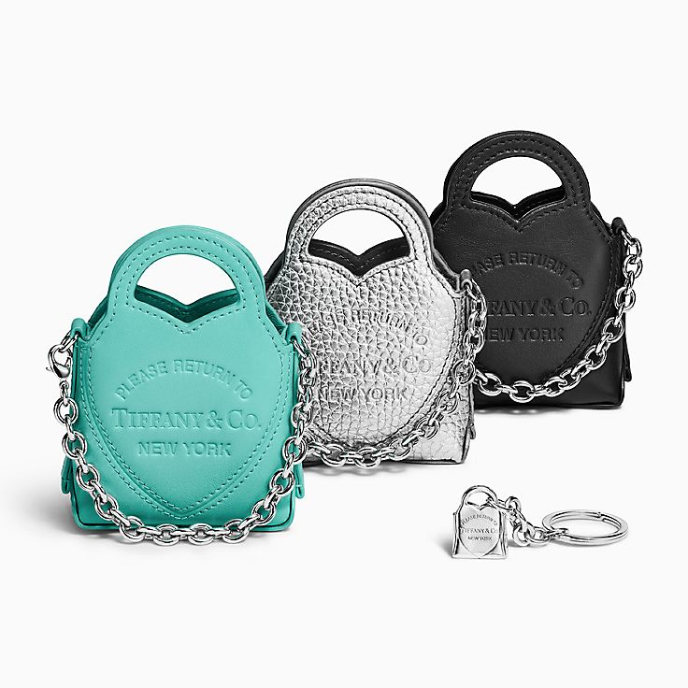
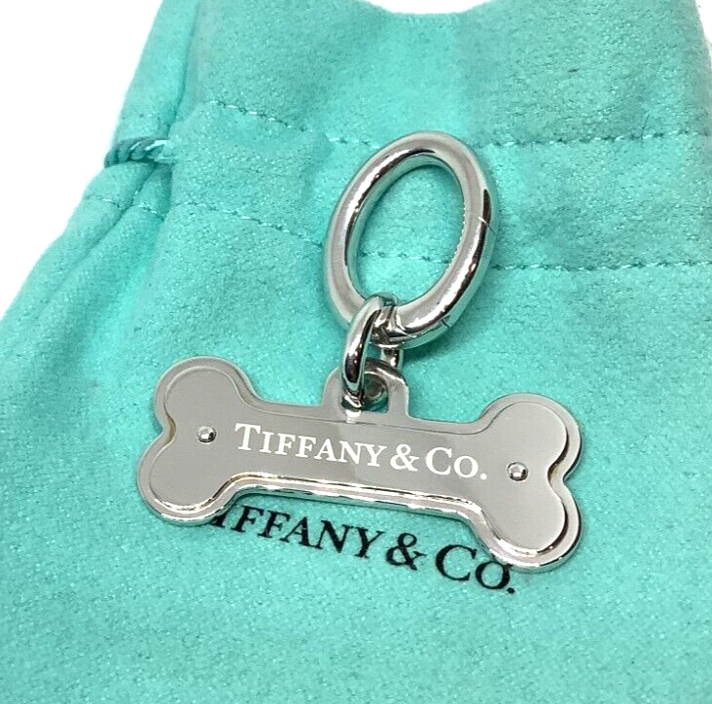
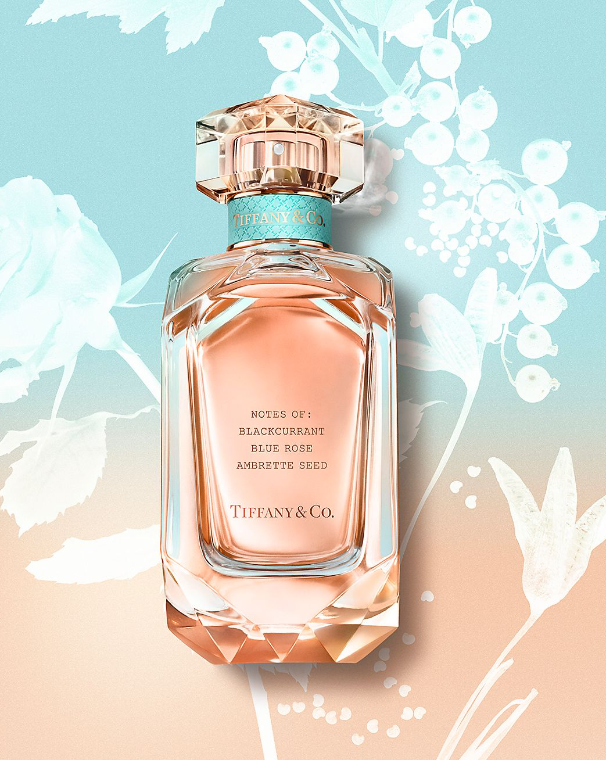
Brand Stretching
Brand Extension: Creating a new product in a different category using an existing name.
Tiffany & Co exemplifies functional brand expansion are they're primarily known for their jewelry & have expanded into marketings including:
  Home decorations, pet care items, leather goods, fragrances, belts, & sunglasses.
Tiffany & Co's ability to create new products allows the consumer to enhance their experience with the brand's original products, while leveraging their brand reputation for exceptional qualities.

Slide 10
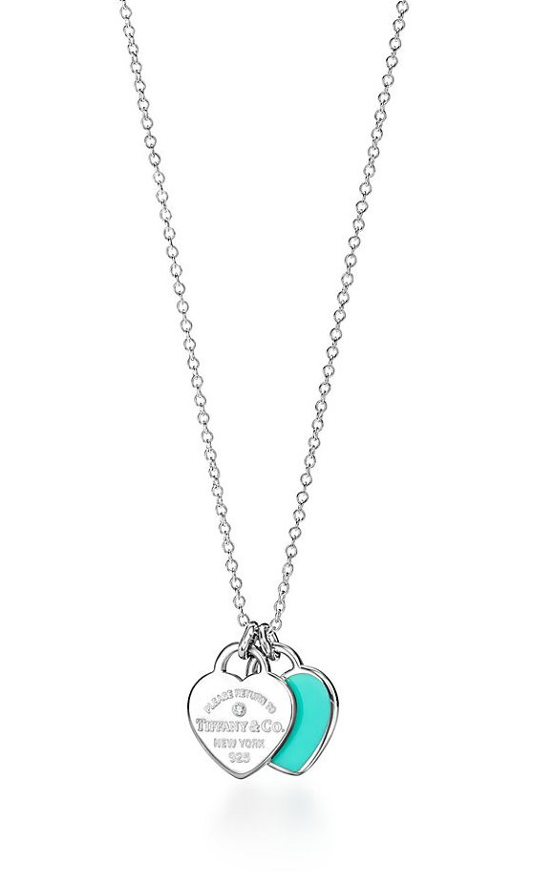
Pricing
PRODUCT: Return to Tiffany Mini Double Heart Tag in Silver with Small Diamond
Debuted in 1969; similar-sized silver pendants with intricate designs were priced between $1-$5 (equivalent to $30-$150 today)
Price Now: $625
Change in Price Over Time:
  2000s: $150-$200
  2010s: $250-$350
  2020s: $625
Slight increases by year to maintain exclusivity of their signature product.

Slide 11
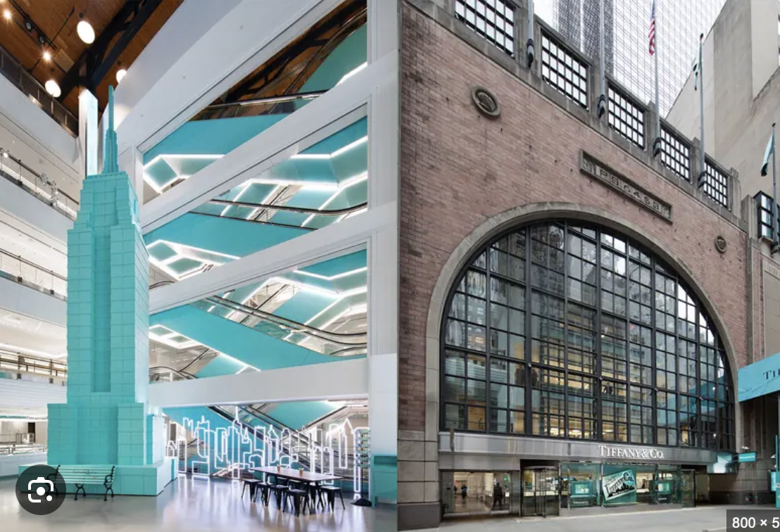
Distribution
Strategy:
Selective distribution strategy
Distribute their products through a carefully curated network of authorized retailers and exclusive stores
Examples:
Using flagship stores, Tiffany operates its own retail outlets, including high-end flagship stores in major cities like NYC, Paris, London, and more.
These stores are a part of the brands strategy to maintain exclusivity and direct connection with customers.
Notes:
What type of distribution does your brand primarily use?

Slide 12
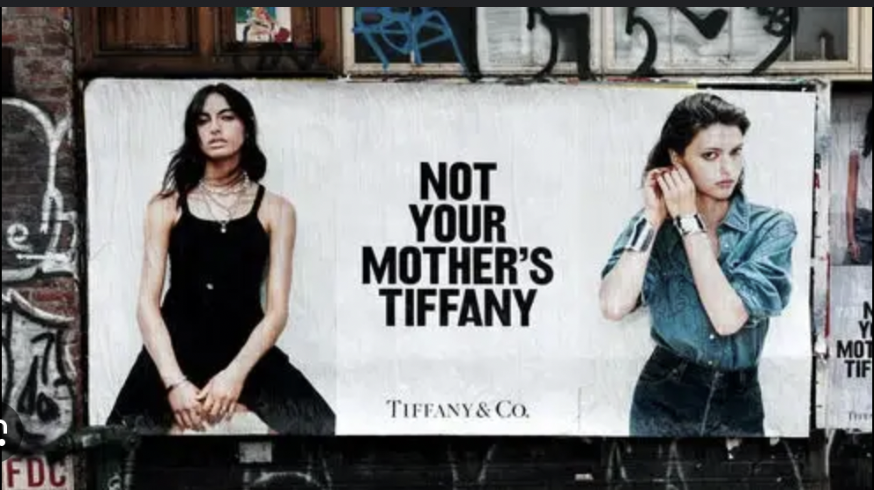
Communication
Tiffany & Co communications topology is a combination of traditional and digital channels.
TRADITIONAL:
Retail stores
Print Advertising
DIGITAL
Website Social Media
Notes:
Retail Stores: Tiffany & Co. maintains a network of high-end stores across the globe, each acting as a touchpoint for personalized customer experiences and brand storytelling.
WEBSITE: The company's website serves as the central hub for product information, brand stories, and online shopping
Print Advertising: The brand utilizes print media, such as magazines and newspapers, to showcase its products and campaigns in a visually stunning way.
Social Media: Tiffany & Co. is active on various social media platforms, including Instagram, Facebook, and Twitter, to connect with a younger audience and share behind-the-scenes content.

Slide 13
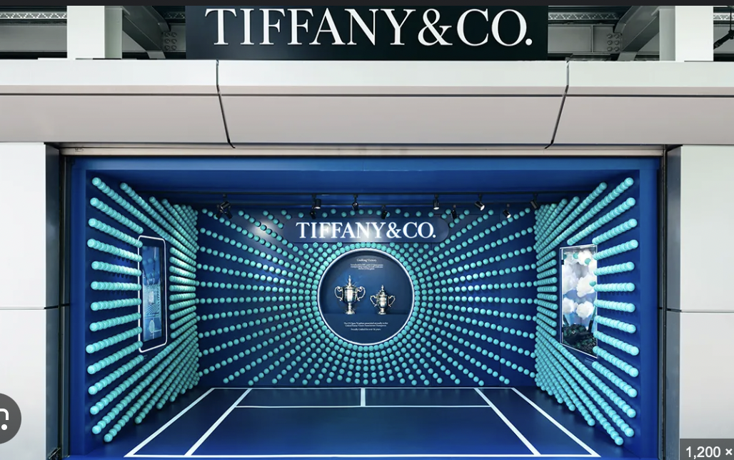
Brand Sponsors
Tiffany & Co and the US Open
Association with Elegance and prestige
Exposure to a global Audience
Unique Marketing Opportunities
Notes:
Association with Elegance and Prestige: Tennis, particularly the US Open, is associated with elegance, athleticism, and a certain level of luxury. By aligning with this event, Tiffany & Co. reinforces its own brand identity as a symbol of luxury and sophistication.
Exposure to a Global Audience: The US Open is a globally televised event, reaching millions of viewers. This significant exposure helps to increase brand awareness and reach a diverse audience, including potential high-net-worth individuals.
Unique Marketing Opportunities: The partnership allows Tiffany & Co. to create unique marketing campaigns and experiences, such as limited-edition jewelry collections inspired by the tournament or exclusive pop-up shops at the event

Slide 14
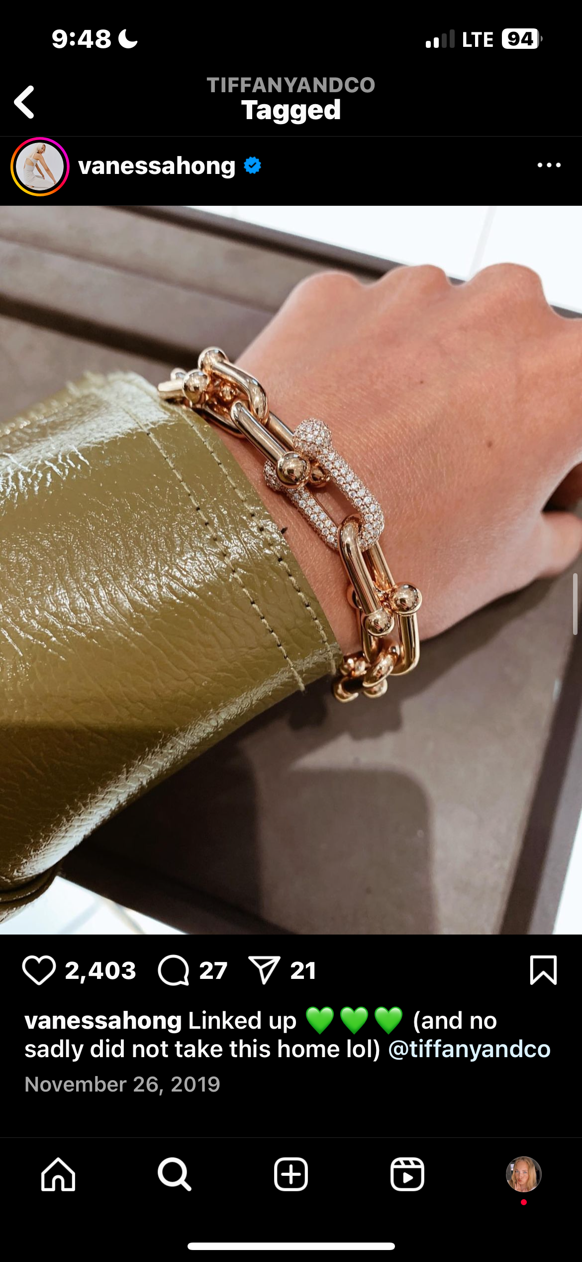
Influencer
On Instagram, Vanessa Hong posts frequently regarding the Tiffany Knot Collection and Hardwear.
Notes:
Find an UNPAID influencer who is talking about your brand, what are they saying

Slide 15
Conclusion-
Tiffany & Co.'s enduring success can be attributed to its strong brand identity, exceptional craftsmanship, and strategic marketing efforts. By understanding its target audience, leveraging digital platforms, and embracing sustainability, the brand is well-positioned to maintain its leadership in the luxury jewelry market.

Slide 16

Thank You! Any Questions?

