Slide 1
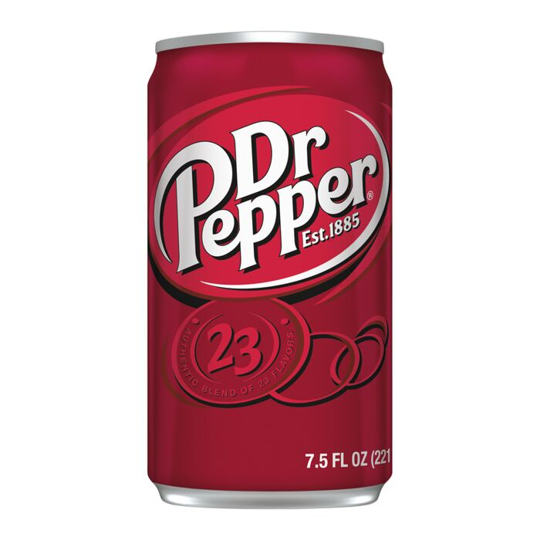
Dr. Pepper Campaign
By: Group 3
Olivia Haines, Mark McFadden, Caitlyn Sanchez, Lily Shutt

Slide 2

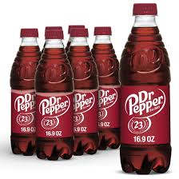
Our Message
Theme: Dr. Pepper Keeps You On Your Toes
Slogan: Put Pep in your step with Dr. Pep
Hashtag: #PutSomePepInYourStep

Slide 3
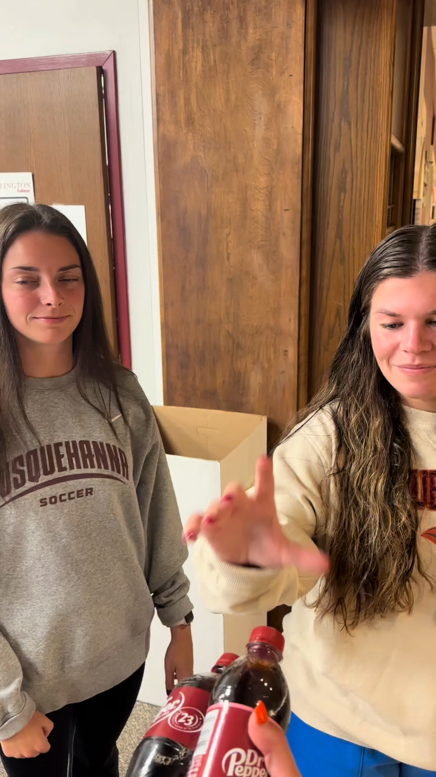
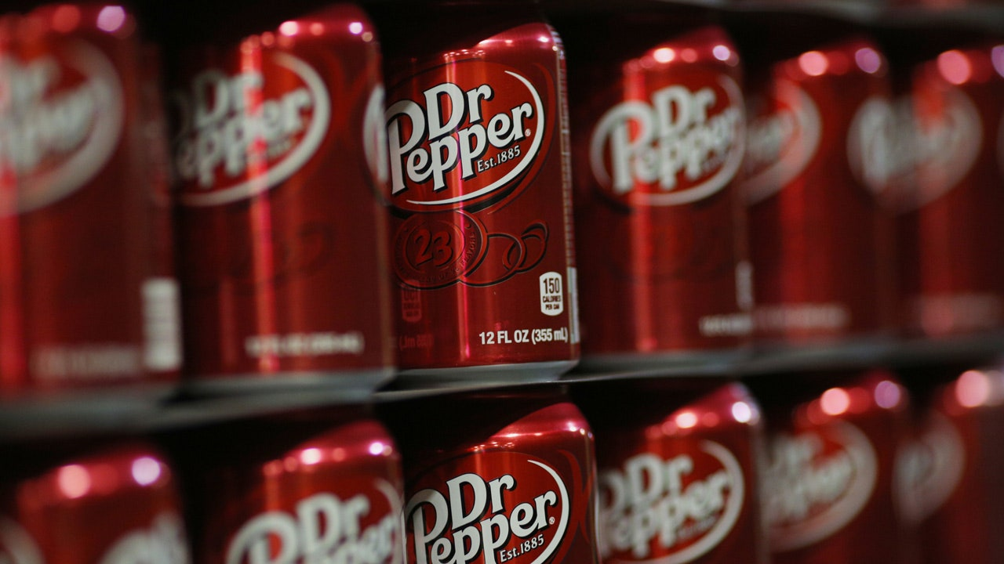
Our Advertisement

Slide 4
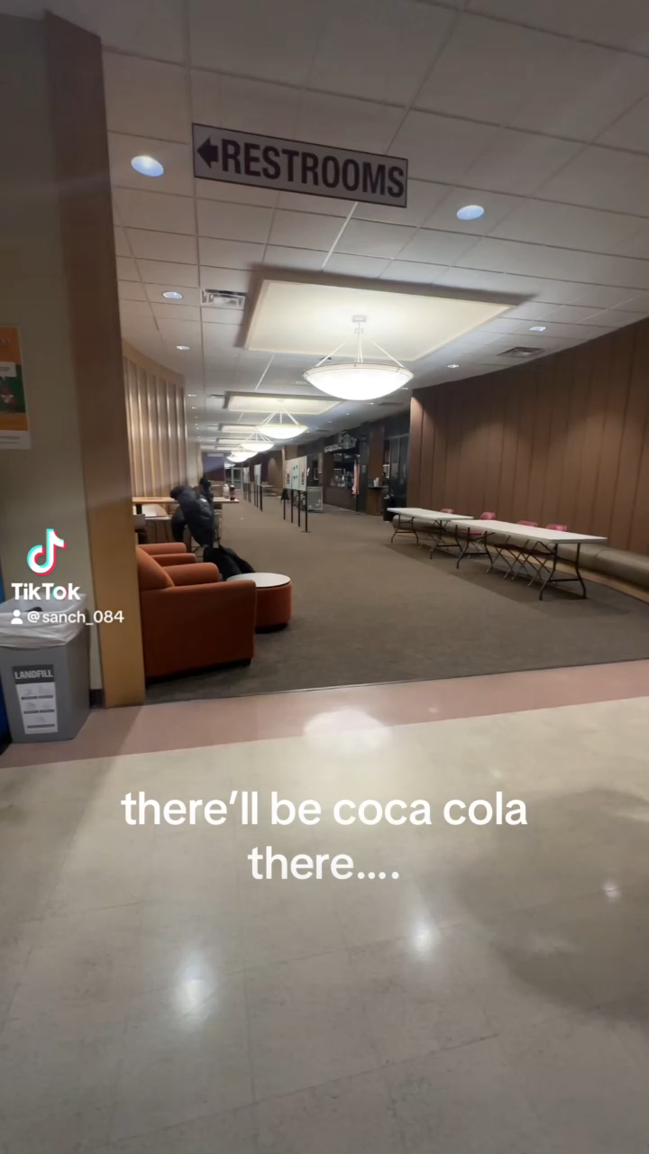
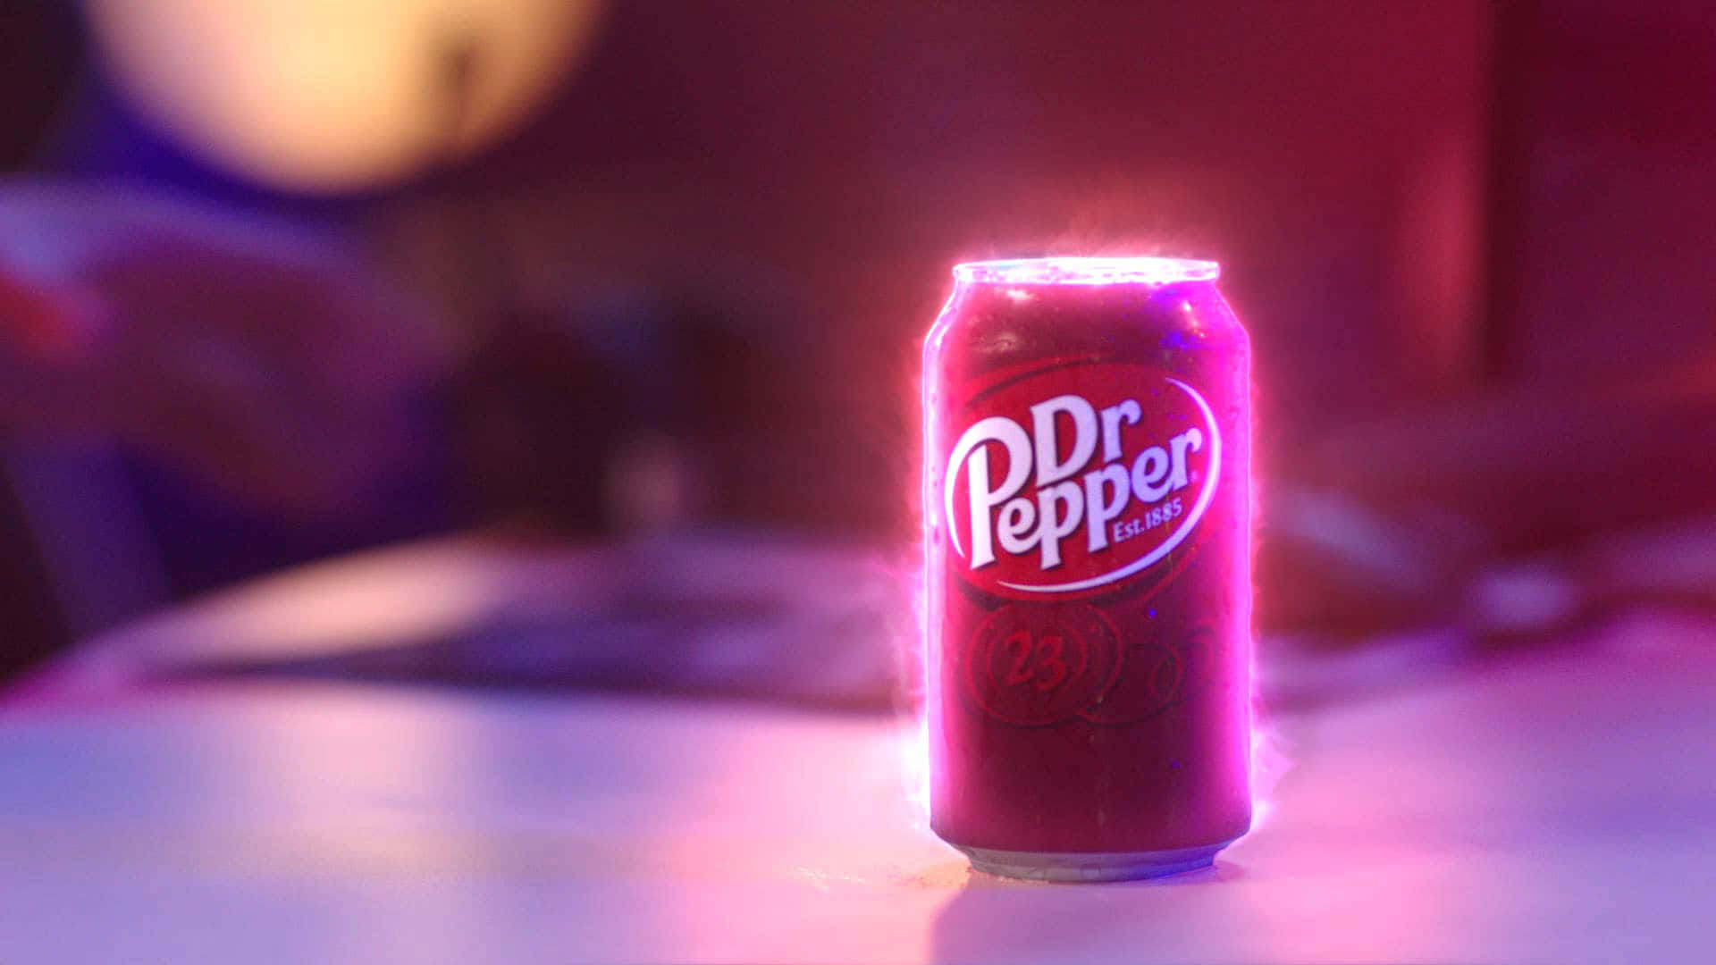
Our Advertisement

Slide 5
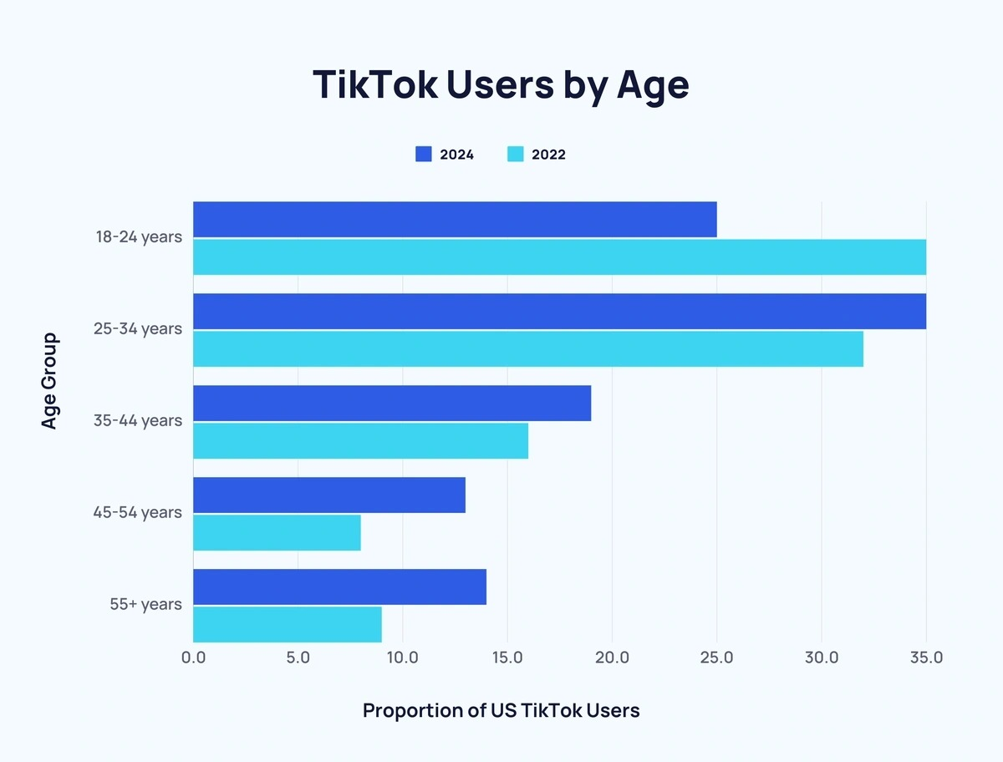
Where To Advertise?
TikTok
Our videos will be posted on Tik Tok appealing to a younger audience
Largest proportion (30%) of US Tik Tok users are 25 to 34 years
55% are under 30 years old
Using Tik Tok allows our advertisement to go viral through repost function

Slide 6
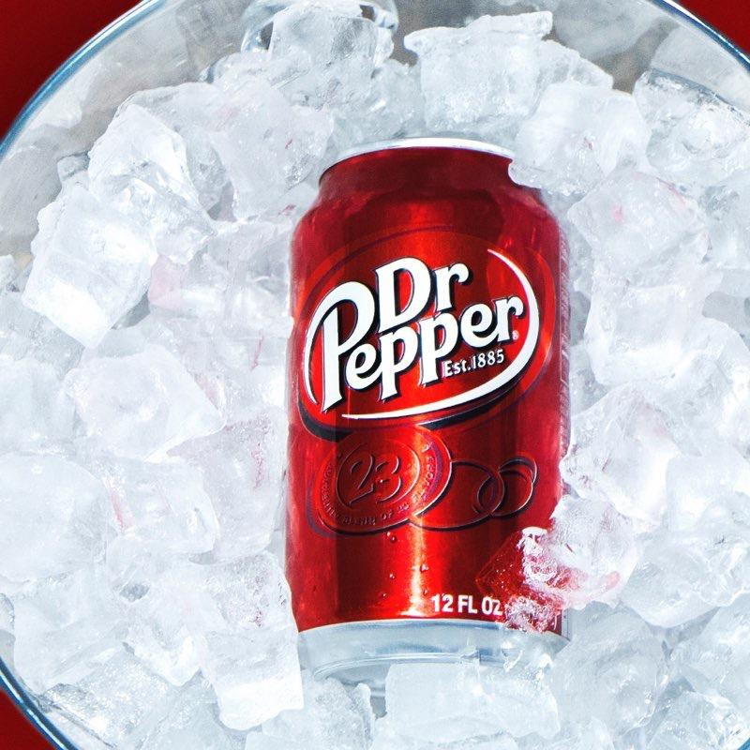

Thank You Any Questions?
Thank You Any Questions?

Slide 7
Citations
https://explodingtopics.com/blog/tiktok-demographics

