Slide 1
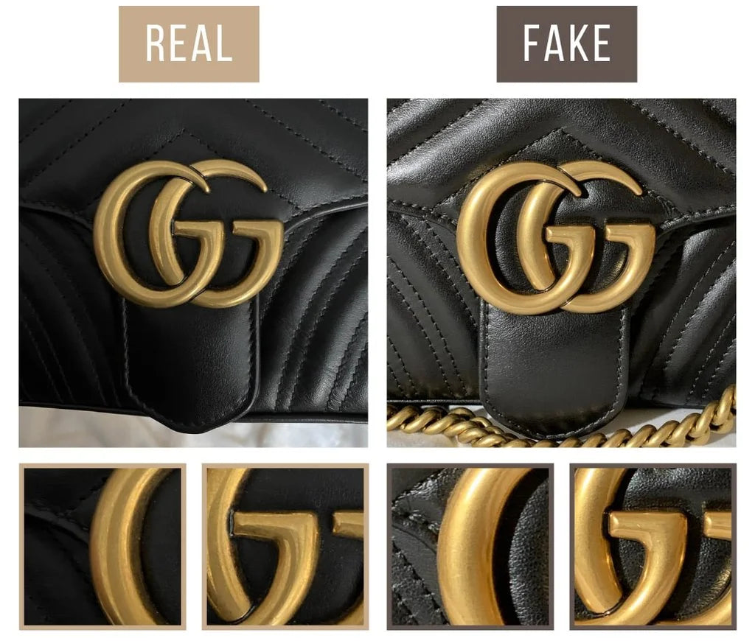
“Dupes” Go Mainstream, What Does This Mean For Luxury Brands?
Lily Shutt

Slide 2
Summary
Designer “dupes” are going viral as shoppers are choosing affordability over luxury.
Buying a knockoff used to be frowned upon as it was considered inferior to the real luxury items.
Brand imitators have elbowed their way into the mainstream.
TikTok, Amazon, Walmart, Costco
Buying a dupe is more “financially responsible” at a time when many consumers feel cash-strapped.
Even when the real thing is available, nearly 33% of adults intentionally purchased a dupe of a premium or luxury product at some point.

Slide 3
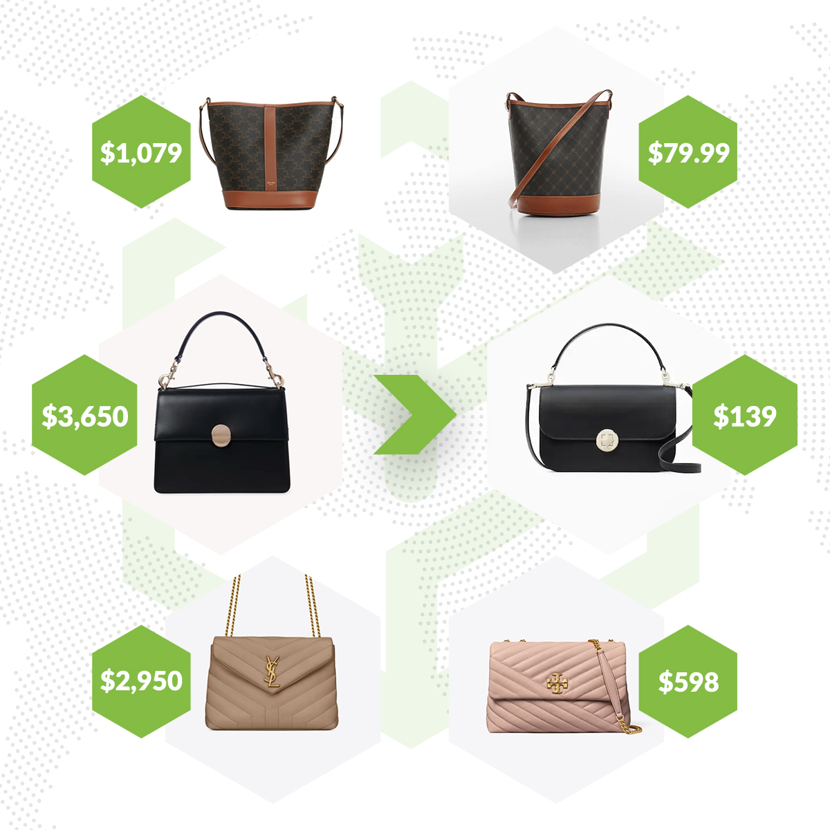
Importance/Relevance to Luxury Industry
The rise of dupes signals a shift in consumer behavior that luxury brands must address or become aware of in order to maintain their market relevance and exclusivity.
Indicates that a significant portion of consumers prioritize affordability over brand prestige.
Platforms such as TikTok and Amazon are driving the popularity of dupes, making it more important for luxury brands to monitor social media trends to protect their brand image.
Some consumers may fall for ”dupes,” therefore, luxury brands should consider emphasizing the differences in quality between authentic products and their imitators.

Slide 4
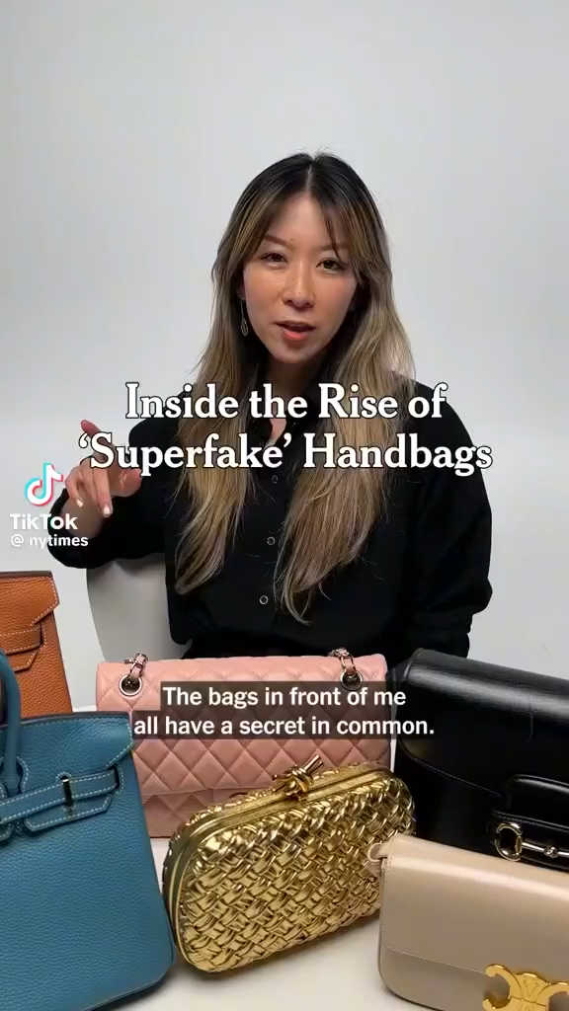
Superfake handbags
https://www.tiktok.com/@nytimes/video/7242709367290727722

Slide 5
Why is This Topic Interesting?
The influence that social media plays in consumer’s lives.
The economic realities that come into play – prioritizing financial responsibilities.
The fine line between imitation and innovation and the ethical boundaries.
The generational differences and shift as dupes were once viewed as inferior, but now have become “popular.”

Slide 6
Discussion Questions
How can luxury brands use their superior quality, craftsmanship, and sustainability efforts to convince consumers that buying the original product is worth the higher price?
Do you think luxury brands should pursue more aggressive legal actions against those producing the dupes?
Or would it alienate potential consumers?

Slide 7
Sources
https://www.cnbc.com/2024/08/14/designer-dupe-demand-soars-a-sign-of-the-economic-times.html
https://www.tiktok.com/@nytimes/video/7242709367290727722
https://uclawsfcomment.org/online-content/legal-realm-of-luxury-brand-duplicates

